Slide 1
Indian Independence
By Abhishek

Slide 2
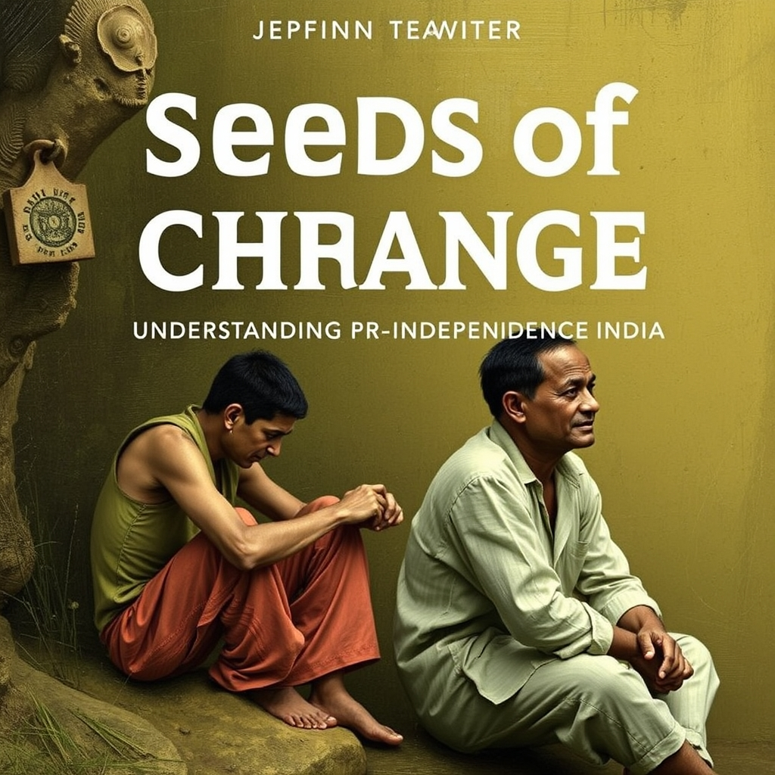
Title: Seeds of Change: Understanding Pre-Independence India
Brief overview of the British East India Company's rise to power.
Social and economic impact of British rule (e.g., exploitation, land policies).
Early resistance movements and their leaders (e.g., Sanyasi Rebellion, Rani Lakshmibai).
Rise of Indian nationalism - factors like education and print media.

Slide 3

Title: The Nationalist Movement: Growth and Ideologies
Early Nationalist organizations and their objectives (e.g., Indian National Congress).
The Era of Moderates vs. the Era of Extremists (key figures and differences).
The Swadeshi Movement and its impact.
The role of Mahatma Gandhi and his philosophy of non-violent resistance (Satyagraha).

Slide 4

Title: Key Events on the Road to Independence
The Jallianwala Bagh Massacre (1919) and its significance.
The Non-Cooperation Movement (1920-1922) and its impact.
The Civil Disobedience Movement (1930-1934) and the Salt Satyagraha.
The Quit India Movement (1942) and its impact on the British.

Slide 5

Title: Partition and Independence: A Bitter-Sweet Victory
The Cabinet Mission Plan and the lead-up to Partition.
The key players and their perspectives on Partition (e.g., Nehru, Jinnah, Gandhi).
The Radcliffe Line and the division of India and Pakistan.
The tragic consequences of Partition: displacement, violence, and communal tensions.

Slide 6
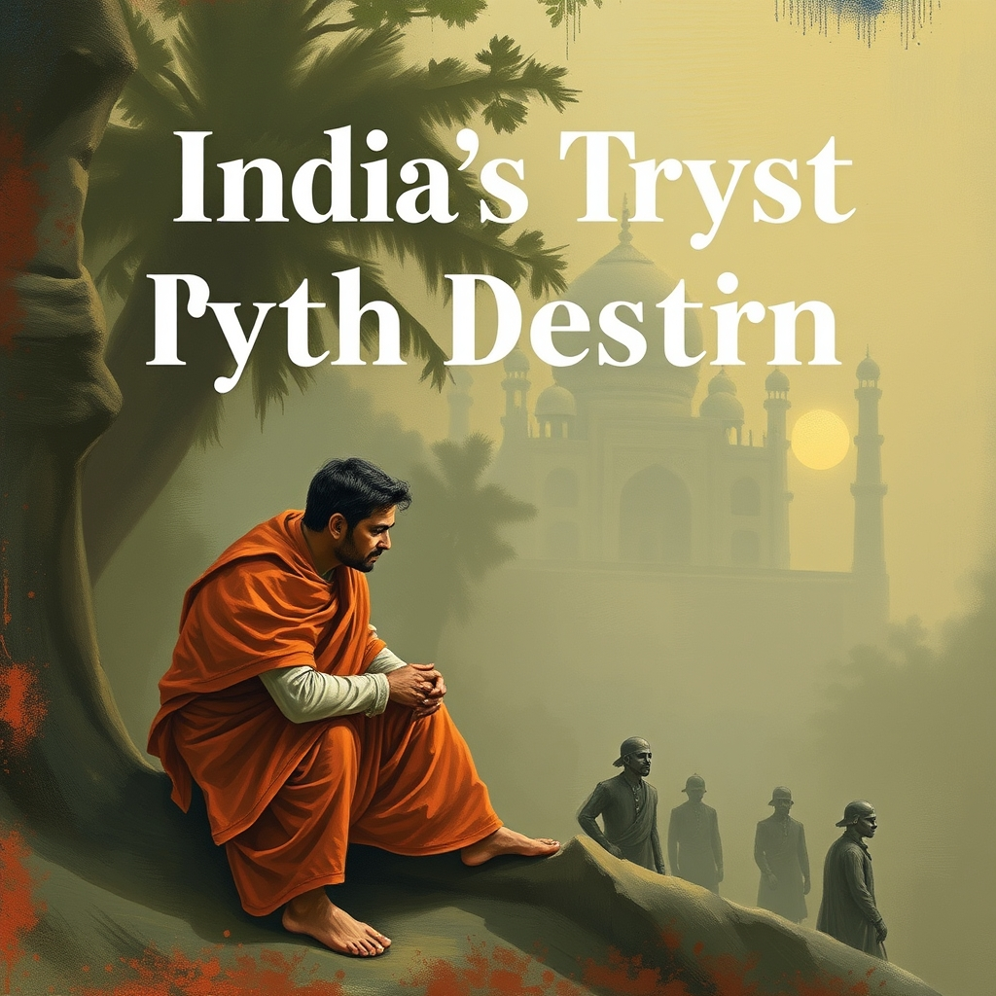
Title: India's Tryst with Destiny: Legacy and Challenges
Jawaharlal Nehru's famous "Tryst with Destiny" speech.
The establishment of the Republic of India and the adoption of the Constitution.
Initial challenges faced by independent India (e.g., poverty, communalism, integration of princely states).
The enduring legacy of the independence movement and its impact on India today.

Slide 7
Thank You!

